Slide 1



Kilkenny GAA
Coaching Conference
2014
“Putting the Player First”

Slide 2
Factors that affect a Players Performance
Rest and Recovery
Diet
Hydration

Slide 3
Fitness Level and Recovery Rate
Fitness Level
A
B
C
Pre-training
fitness level
Overload
Restoration
Workout
A=Highly trained
B=Moderately trained
C=Untrained
0
1
2
3
4
5
6
7
Days

Slide 4
Inadequate Recovery
Fitness Level
Session 1
Session 2
Session 3
Days

Slide 5
Progression
B
Session 3
Fitness Level
Session 2
Session 1
A
Current Fitness Level

Slide 6
Current Practice
Fitness
Year 1
Year 2
Year 3
Time (years)

Slide 7
Yearly Progression
B
Year 3
Fitness Level
Year 2
Year 1
A
Fitness level at the start of year 1

Slide 8
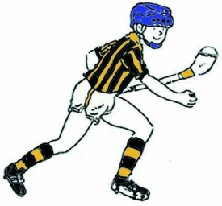
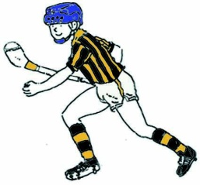
One Size does not fit all
Training has to be individualised .... To some extent
Light Fit player & Heavy “not so fit” player doing same runs,
- with fit player leaving other player a mile behind ALWAYS.
Not good for either player-
-Fit player not being challenged
-Unfit player feeling .....useless!
Train at a pace that extends you .... Not kills you
Allow sufficient recovery so that you are not “fatigued” commencing the next session

Slide 9
Most Teams Loose!
12 Teams in a Championship
1 Winner ……11 Losers.
That does not mean that there was 1 good coach & 11 poor coaches.
No matter how good all the coaches are –
there will still be only 1 Winner
The winning team does not necessarily have the best coach
There are other factors that result in a team winning

Slide 10
A Good Coach-
A good Coach / Trainer / Manager will not necessarily improve a team or player!
but
A bad Coach / Trainer / Manager could destroy them.
Your own Self-esteem..... Your Value!

Slide 11
Give All Players Games
Keep a record of the games that all members play as the year progresses
Monitor it regularly and make a point of ensuring that all players get at least 10 full games in the year???? .... Why do we lose players?
Keep a journal of Squad/ Individual weaknesses.
Pass information on to next coach or coaching co-ordinator.
Address weaknesses – Do Skills Tests (mfogarty@iol.ie)

Slide 13
Coaching ...what is important?
Give Players your Time
Give Players Encouragement
Give Players your Interest
Give Players Dreams!
Infect them with enthusiasm
Have a word for EVERY Player

Slide 14
Who can Coach?
Anyone that is.....
Good Humoured
Happy
Interested
Firm
Enthusiastic
Has a word for EVERY Player
Always sees the glass- Half Full

Slide 15
What is a good Training Session ?
A few pucks to warm up
....................followed by a good Match
  Balance the teams
  Match players of similar ability
  Condition game so that there is plenty of ball at each end
  Give players experience in a variety of positions

Slide 16
Take Care of your players
Use Common Sense
Consult & Co-operate with other coaches
together- plan out a players week/month
Players welfare has to take priority
Don’t burn them out
If they are playing several games / grades – they do NOT need extra training they need.....REST

Slide 17
Injuries!
If a young player says he / she is injured
then ....he / she IS injured!
All youngsters want to do is PLAY ..they will not feign injury
Acquire a basic knowledge of Common & Key injuries & learn “What not to do!”
Be aware of some common conditions that children suffer from.

Slide 18
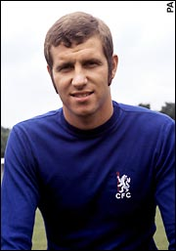
Peter Osgood
Claire might Address-
Knee or back pain in a child
Recovery plan and “back to playing progression” for injuries such as hamstrings and ankle ligament injuries
....players are often bullied into coming back too soon and going straight into full matches!
Shoulders popping out

Slide 19
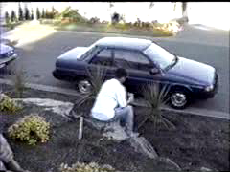
The Hit!!
Be Ready for it
It will come....
...when you least expect it
..from where you least expect it

